Slide 1



Arab Academy for Science , Technology & Maritime Transport
College of Computing and Information Technology
Data Structures
and Algorithms (CS212)
Section 01 : Introduction
Eng. Youssef Ahmed Mehanna
Youssefmohana7@gmail.com

Slide 2
Section Index
What is Data Structures ?
Course Assessment
Pointer & Structures Quick Revision
How to use Pointers with Structures
C vs C++

Slide 3
What is Data Structures
Different Ways of Storing Data in Memory
Single Linked Lists
Double Linked Lists
Circular Linked Lists
Stacks
Queues
Tree
Graph
Hashtables

Slide 4
Pointers
Is a variable used to point to other variables (or to store memory addresses) .
It can be int , float , char , etc…. But it must be the same type of the variable that points to it
dataType *ptr;
Syntax

Slide 5
Pointers : example
PART1
int x = 5 ;
int *ptr = &x ;
&x = means
Address of x
Pointer | Points to
*ptr | 0x23FD74
Variable | Value | Address
x | 5 | 0x23FD74
To access the value of x : x or *ptr
To access the address of x : &x or ptr

Slide 6
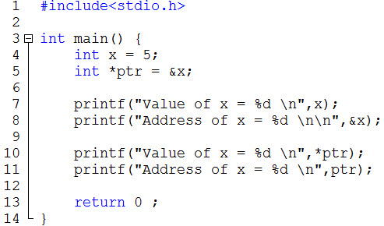
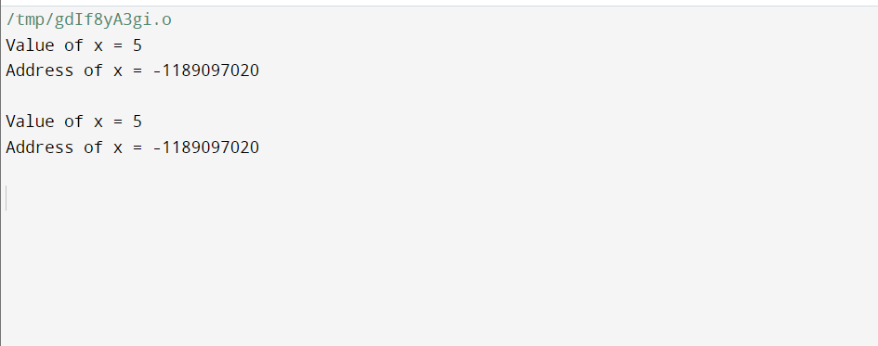
Pointers : example
Print the value of x and it’s address
Run:
To access the value of x : x or *ptr
To access the address of x : &x or ptr

Slide 7
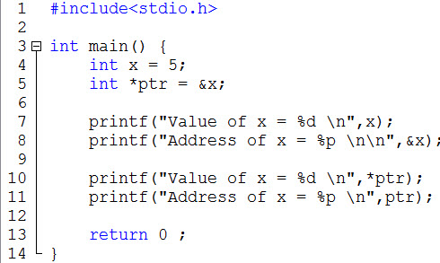
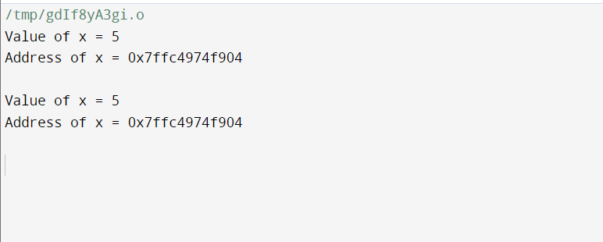
Pointers : example
Run:
Use placeholder %p
To print memory in hex
To access the value of x : x or *ptr
To access the address of x : &x or ptr

Slide 8
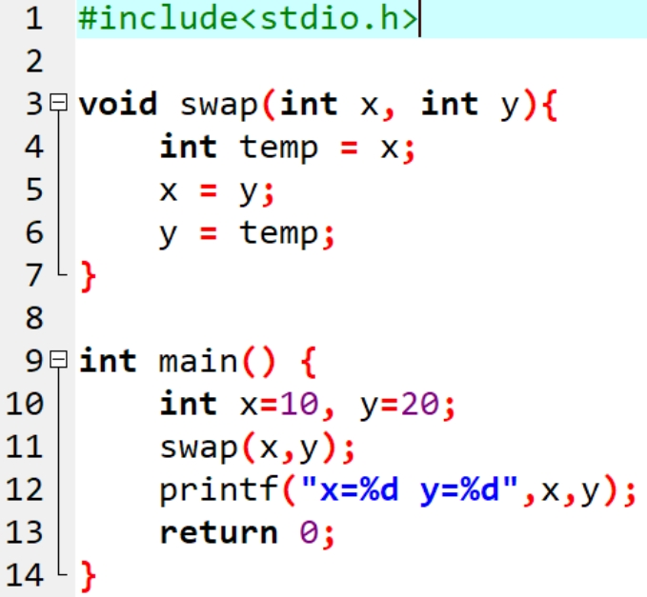
Swap X and Y using Pointers
This Code Have a problem, let’s find it

Slide 9
Swap X and Y using Pointers
Main
x=10
y=20

Slide 10
Swap X and Y using Pointers
Main
x=10
y=20
swap
x=10
y=20

Slide 11
Swap X and Y using Pointers
Main
x=10
y=20
swap
x=10
y=20
temp=10

Slide 12
Swap X and Y using Pointers
Main
x=10
y=20
swap
x=20
y=20
temp=10

Slide 13
Swap X and Y using Pointers
Main
x=10
y=20
swap
x=20
y=10
temp=10

Slide 14

Swap X and Y using Pointers
Main
x=10
y=20
swap
x=20
y=10
temp=10
Nothing Changed, So We must use reference
(pointers)

Slide 15
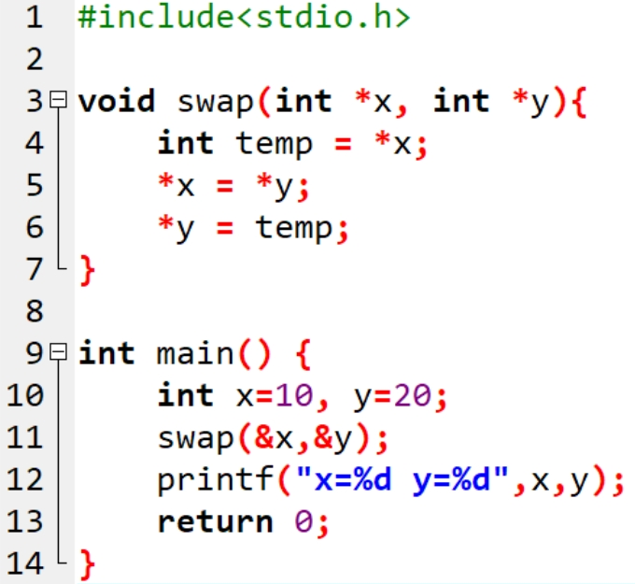
Swap X and Y using Pointers

Slide 16
Swap X and Y using Pointers
Main
x=10
y=20

Slide 17
Swap X and Y using Pointers
Main
x=10
y=20
*x
*y

Slide 18
Swap X and Y using Pointers
Main
x=10
y=20
swap
temp=10
*x
*y

Slide 19
Swap X and Y using Pointers
Main
x=20
y=20
swap
temp=10
*x
*y

Slide 20
Swap X and Y using Pointers
Main
x=20
y=10
swap
temp=10
*x
*y

Slide 21

Swap X and Y using Pointers
Main
x=20
y=10
swap
temp=10
*x
*y
Output

Slide 22
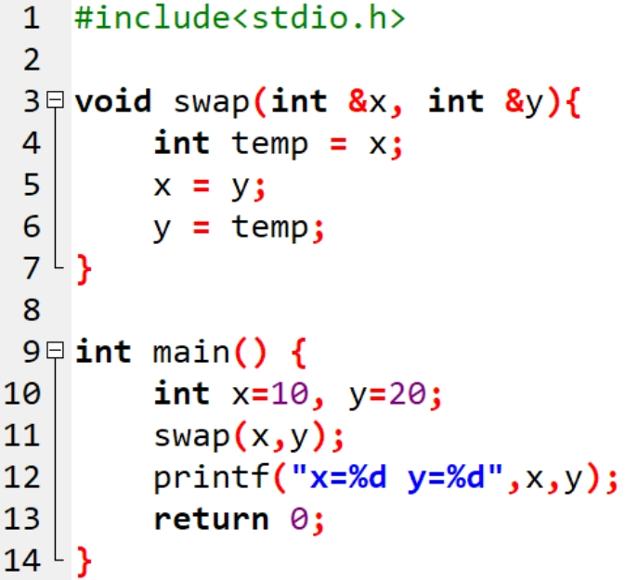
Swap X and Y using Pointers
C Pointers
C++ Ref

Slide 23
Revision on Structures
is a complex data type declaration that defines a grouped list of variables to be placed under one name in a block of memory
struct structName {
dataType variable1 ;
dataType variable2 ;
. .
dataType variableN ;
};
Syntax

Slide 24
Structures: Example
Define a struct that stores the information about students (name, age, GPA, semester). Then Create 2 Students First Student’s Name is Ahmed, age=20, GPA=3.2, semester=4
Second Student’s Name is Mohamed, age=21, GPA=3.5, semester=7

Slide 25
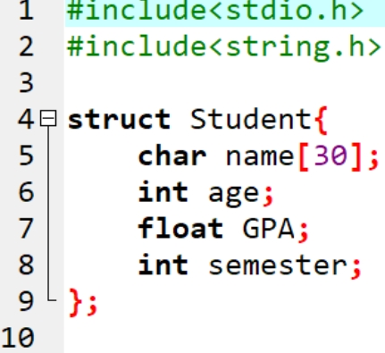
Structures: Example
Define a struct that stores the information about students (name, age, GPA, semester). Then Create 2 Students First Student’s Name is Ahmed, age=20, GPA=3.2, semester=4
Second Student’s Name is Mohamed, age=21, GPA=3.5, semester=7

Slide 26
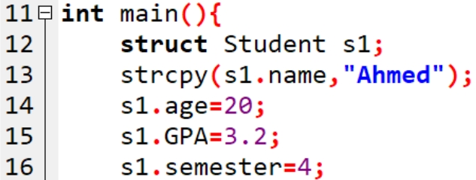
Structures: Example
Define a struct that stores the information about students (name, age, GPA, semester). Then Create 2 Students First Student’s Name is Ahmed, age=20, GPA=3.2, semester=4
Second Student’s Name is Mohamed, age=21, GPA=3.5, semester=7

Slide 27
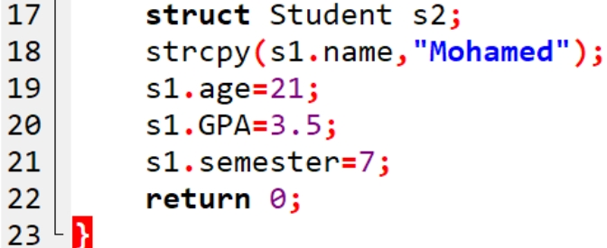
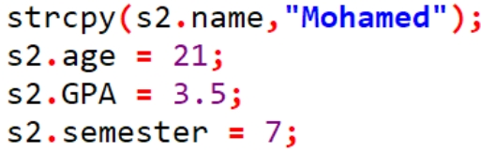
Structures: Example
Define a struct that stores the information about students (name, age, GPA, semester). Then Create 2 Students First Student’s Name is Ahmed, age=20, GPA=3.2, semester=4
Second Student’s Name is Mohamed, age=21, GPA=3.5, semester=7

Slide 28
Structures: Example
Solve the same problem but this time use Pointers
Define a struct that stores the information about students (name, age, GPA, semester). Then Create 2 Students First Student’s Name is Ahmed, age=20, GPA=3.2, semester=4
Second Student’s Name is Mohamed, age=21, GPA=3.5, semester=7

Slide 29
Structures: Example
Solve the same problem but this time use Pointers
Define a struct that stores the information about students (name, age, GPA, semester). Then Create 2 Students First Student’s Name is Ahmed, age=20, GPA=3.2, semester=4
Second Student’s Name is Mohamed, age=21, GPA=3.5, semester=7

Slide 30
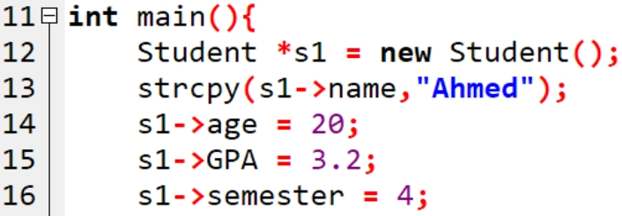
Structures: Example
Solve the same problem but this time use Pointers
C++ Only
Define a struct that stores the information about students (name, age, GPA, semester). Then Create 2 Students First Student’s Name is Ahmed, age=20, GPA=3.2, semester=4
Second Student’s Name is Mohamed, age=21, GPA=3.5, semester=7

Slide 31
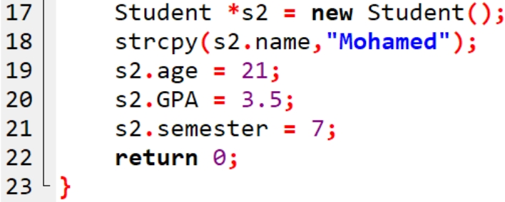

Structures: Example
Solve the same problem but this time use Pointers
C++ Only
Define a struct that stores the information about students (name, age, GPA, semester). Then Create 2 Students First Student’s Name is Ahmed, age=20, GPA=3.2, semester=4
Second Student’s Name is Mohamed, age=21, GPA=3.5, semester=7

Slide 32
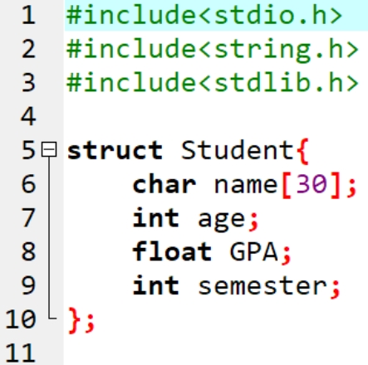
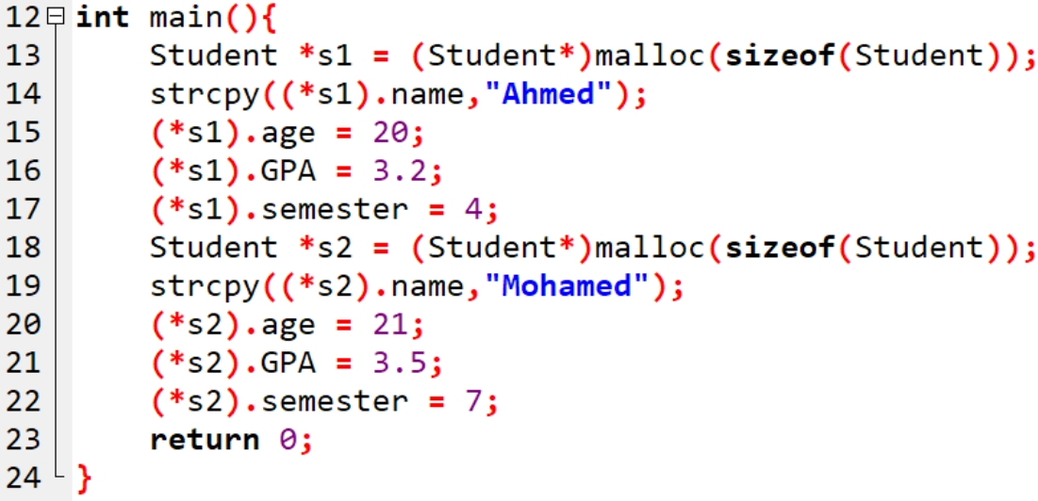
Structures: Example
Solve the same problem but this time use Pointers
C Only
Define a struct that stores the information about students (name, age, GPA, semester). Then Create 2 Students First Student’s Name is Ahmed, age=20, GPA=3.2, semester=4
Second Student’s Name is Mohamed, age=21, GPA=3.5, semester=7

Slide 33
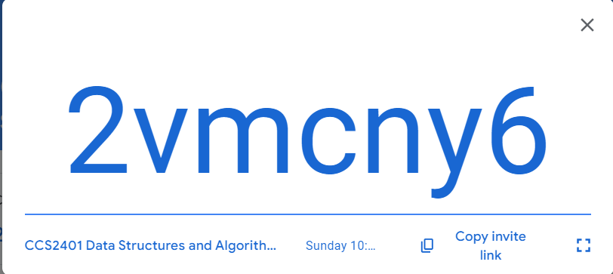
Sunday 10:30
Classroom Code

Slide 34
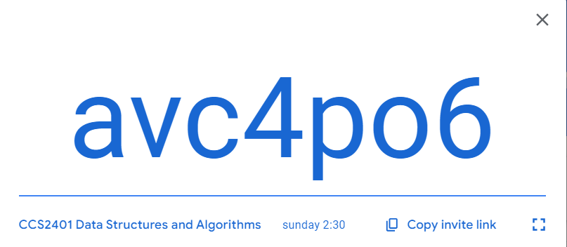
Sunday 2:30
Classroom Code

Slide 35
END of Section
Thank You ☺

